Slide 1

Hackathon 2024
Engineering for Humanity

Slide 2
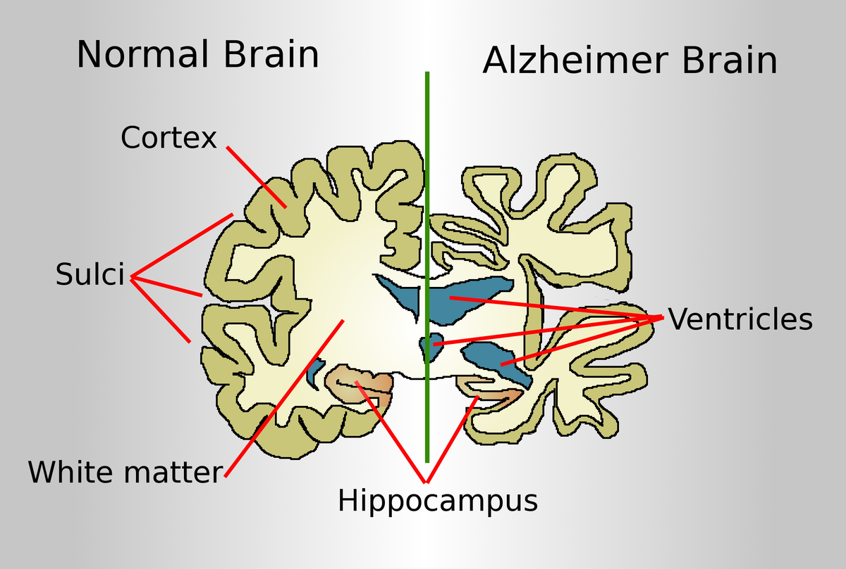
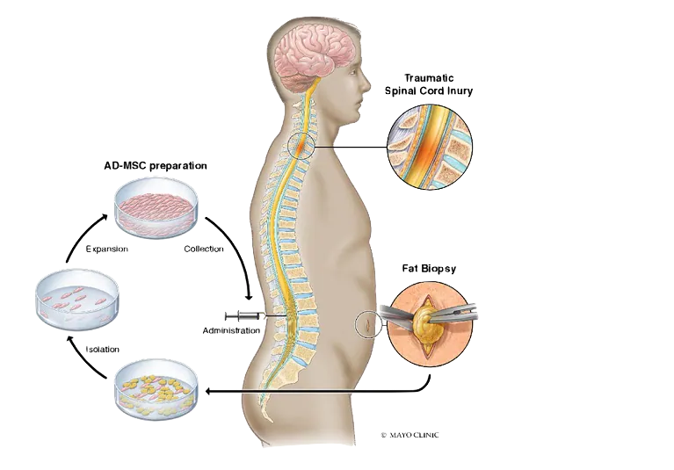

Hackathon
Themes
Spinal Cord Regeneration
Alzheimer’s Disease
Banana
& Biodiversity

Slide 3
Logistics
3 teams: groups of four or five [randomly assigned]
blinded judges for the final presentation + in-room advisors
Hackathon Intro: 2:00-2:20 p.m. BT
Hack Away: 2:20 - 5:00 p.m. BT
Presentations: 5-6 p.m. BT
challenge prompts + preliminary data are exemplars
you’ll want a project + team name

Slide 4
</unsolicited advice>

Slide 5
What to Answer For:
What is the Big Picture Significance?
What is the Solution?
What biology helps me understand my Solution?
What data supports my Solution?
Do I understand the data that supports my Solution?

Slide 6


Slide 7
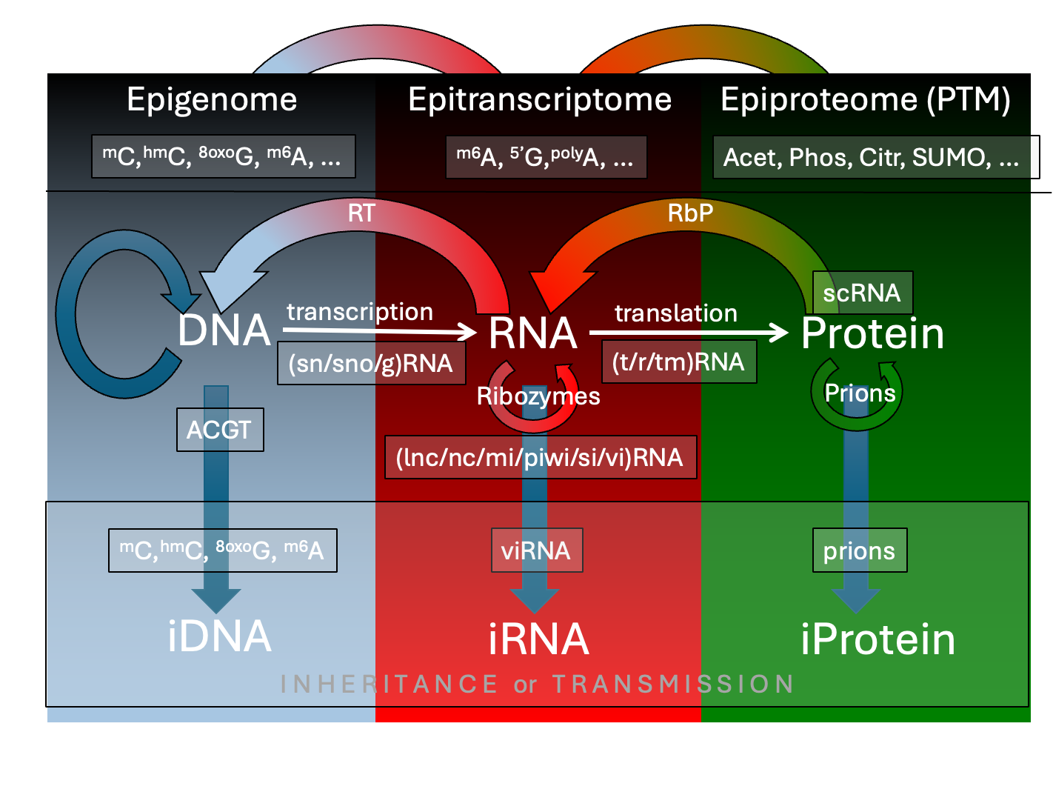

Slide 8
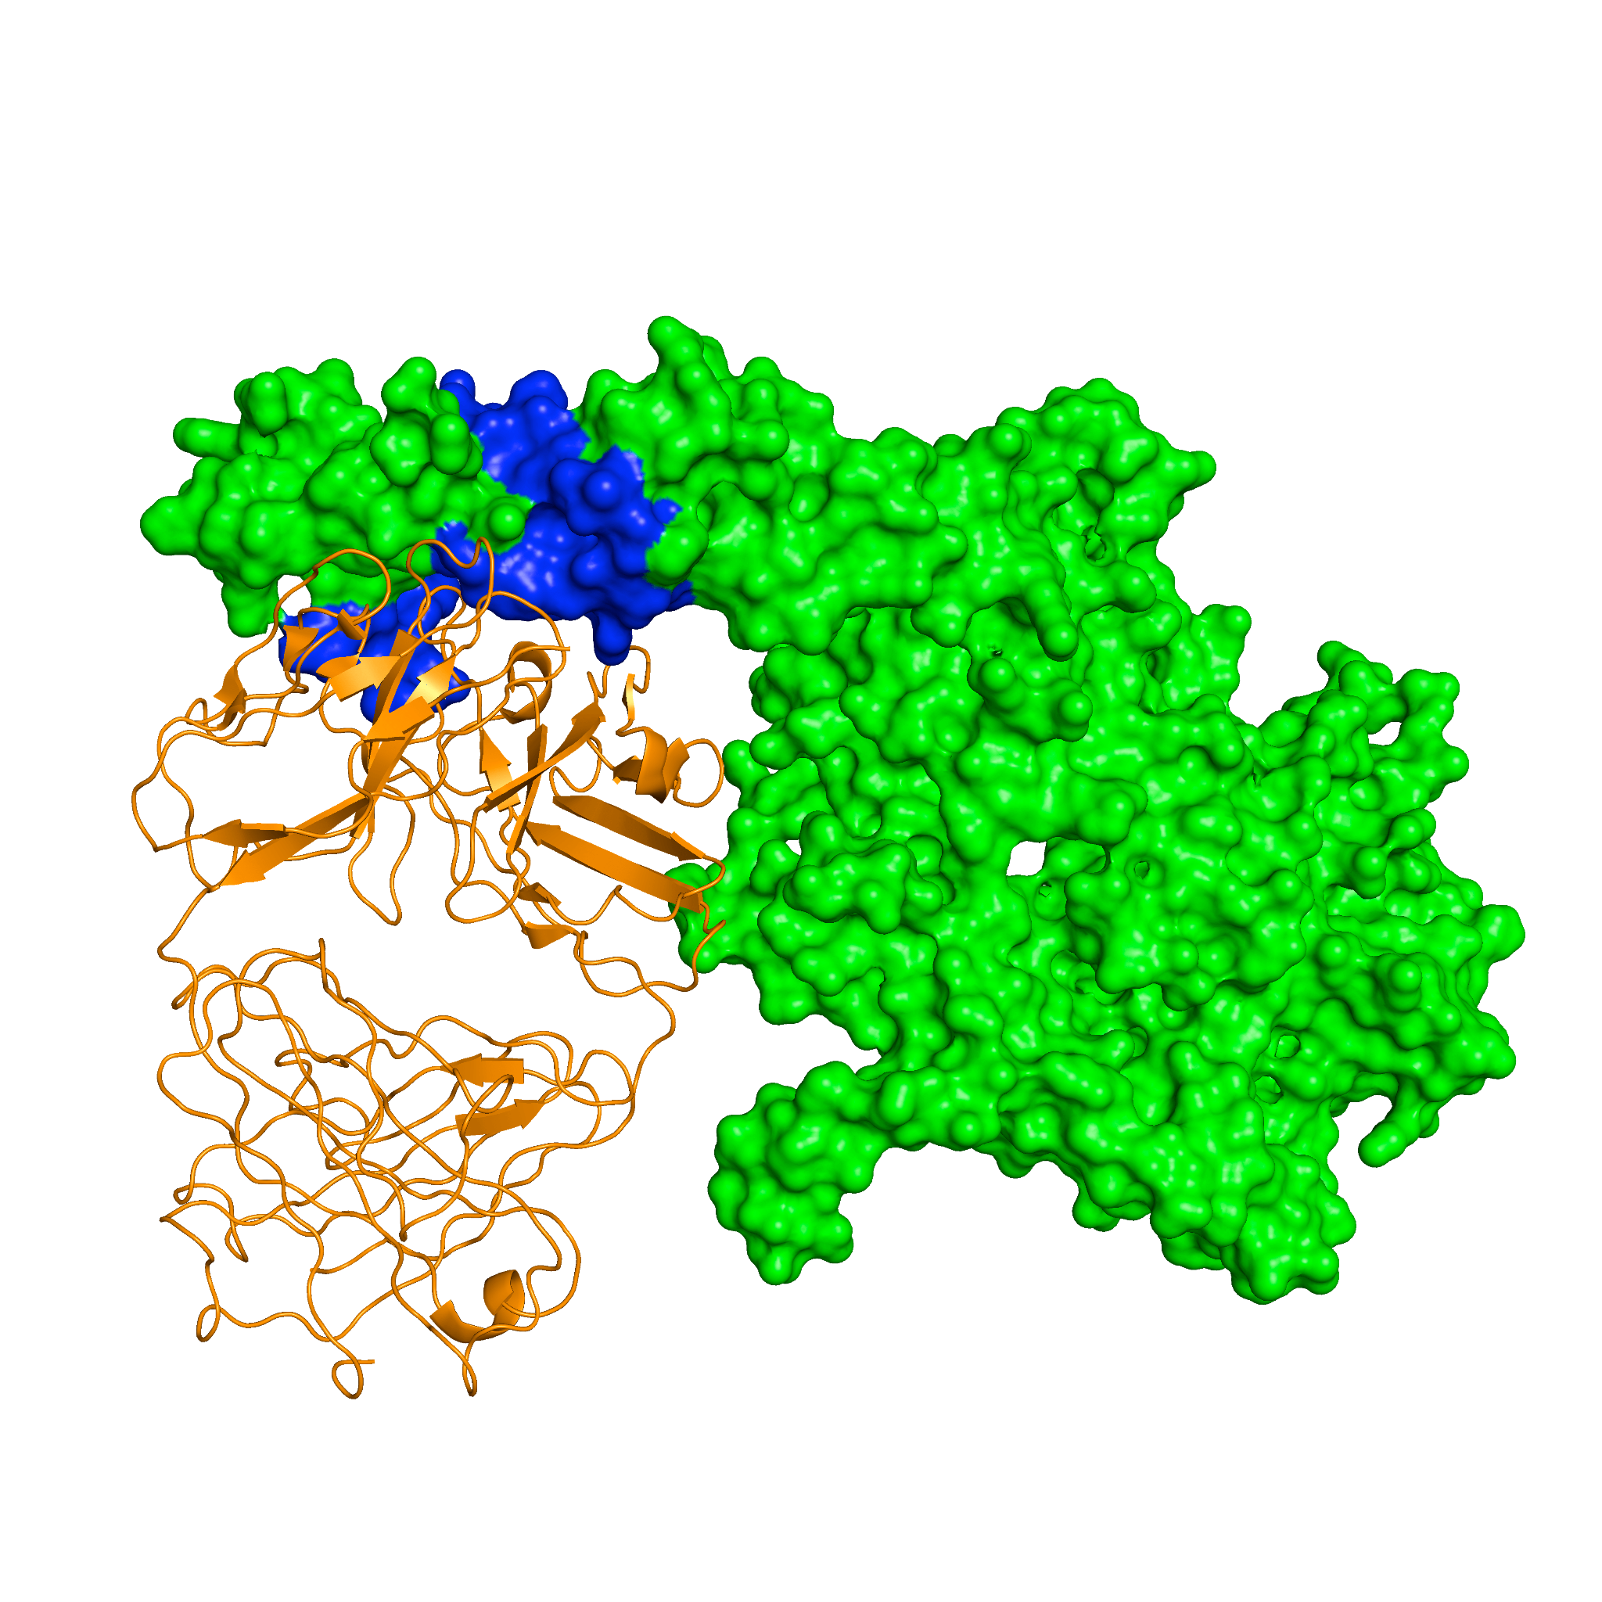
What does it interact with?
What evidence?
Why?

Slide 9
What is known?
What is unknown?
Guess the Great Unknown

Slide 10
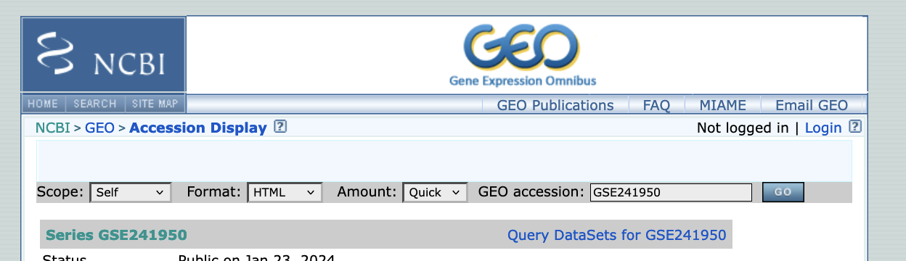


Your Own Data

Slide 11
</Data Review>

Slide 12
Good Luck!

